Slide 1
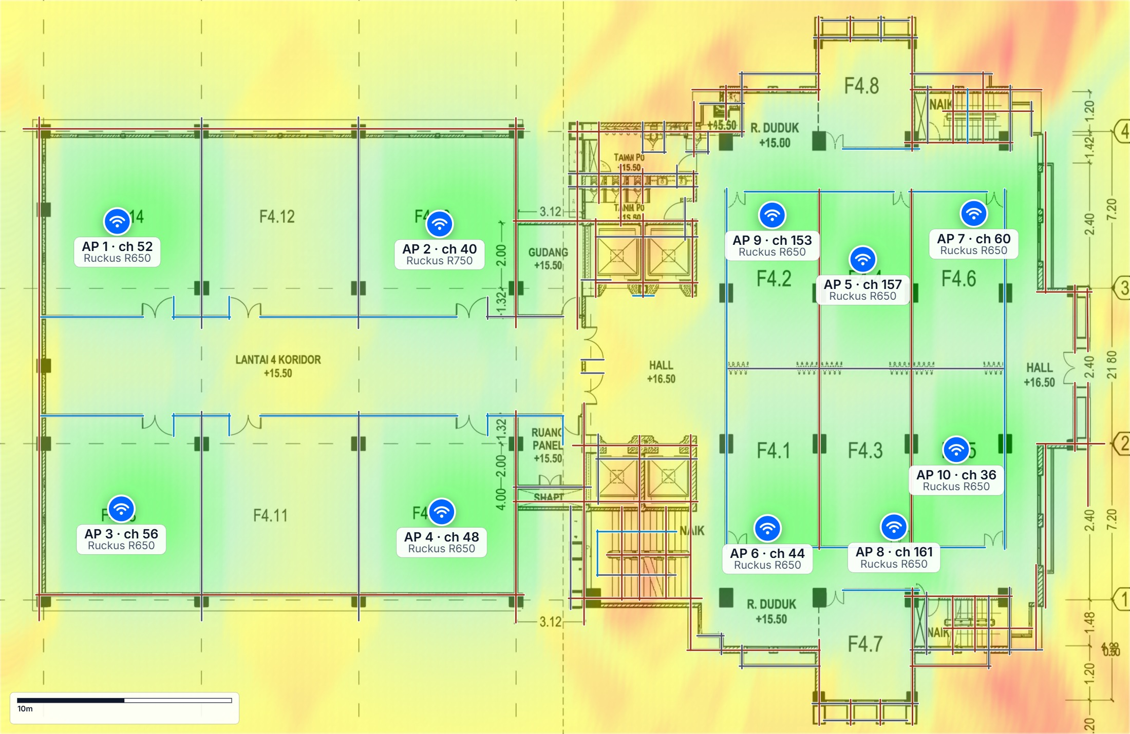
Kelompok 6
WIRELESS DESIGN REPORT
Lantai4
Prepared by Kelompok 6
October 11, 2026
87.7% coverage · 10 access points · 1,807 m²
Signal Strength — predicted

Slide 2
OVERVIEW
Executive summary
The design for Lantai4 at a glance.
87.7%
10
128
1,807 m²
COVERAGE ≥ -70 DBM
ACCESS POINTS
WALLS MODELLED
FLOOR AREA
AT A GLANCE
HOW IT WAS PREDICTED
10 × Ruckus R650, Ruckus R750 and others on 5GHz.
6 coverage layers follow: Signal Strength, Data Rate, Signal-to-Noise Ratio, Channel Interference, User Capacity, Secondary Coverage.
Predicted coverage is 87.7% — review the orange/red areas on the Signal Strength page and move or add one access point.
Validate the design with a post-installation survey and adjust channels and power from measured data.
Model: Free-space path loss + wall attenuation
Environment: office
Client device: Reference client
Direction: downlink
Threshold: -70 dBm
Ceiling: 4.0m
Plan size: 53m × 34m
Kelompok 6 · Lantai4 · October 11, 2026
2 / 11

Slide 3
COVERAGE LAYER
Signal Strength
Predicted received signal (dBm) from the strongest access point at every point of the floor.
87.7%
COVERAGE ≥ −70 DBM
READING THIS MAP
Green and light green are where laptops, phones and voice devices will work without complaint.
Yellow is usable for browsing and email; orange and red will drop calls and stall video.
The coverage figure counts points at or above −70 dBm.
LEGEND
Excellent ≥ -57 dBm
Good -65 to -57 dBm
Fair -70 to -65 dBm
Poor -80 to -70 dBm
Bad < -80 dBm
Kelompok 6 · Lantai4 · October 11, 2026
3 / 11

Slide 4
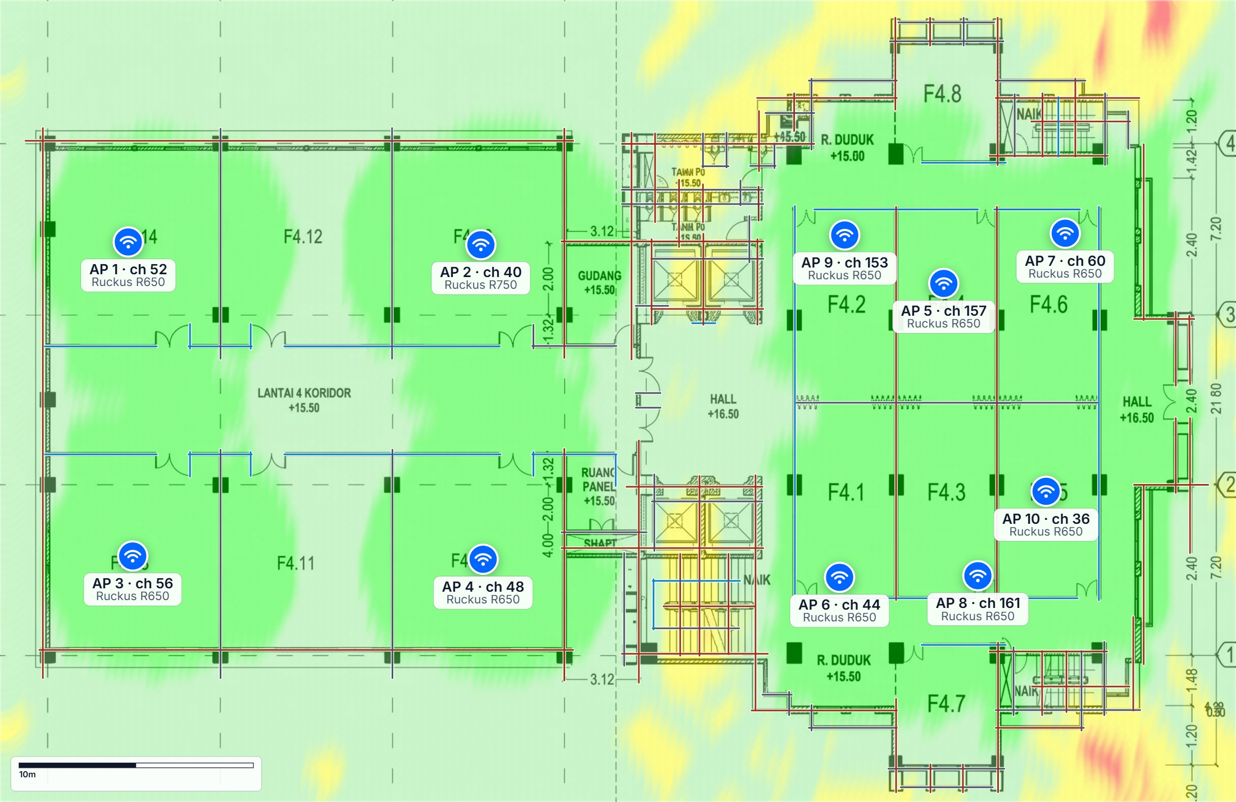
COVERAGE LAYER
Data Rate
Achievable physical-layer data rate given the signal at each point.
READING THIS MAP
Rates fall in steps as signal weakens; the map shows where video, backups and large transfers will be slow.
Clients share an access point, so real throughput per user is lower in busy areas.
LEGEND
Excellent ≥ 800 Mbps
Good 400-800 Mbps
Fair 100-400 Mbps
Poor 24-100 Mbps
Bad < 24 Mbps
Kelompok 6 · Lantai4 · October 11, 2026
4 / 11

Slide 5
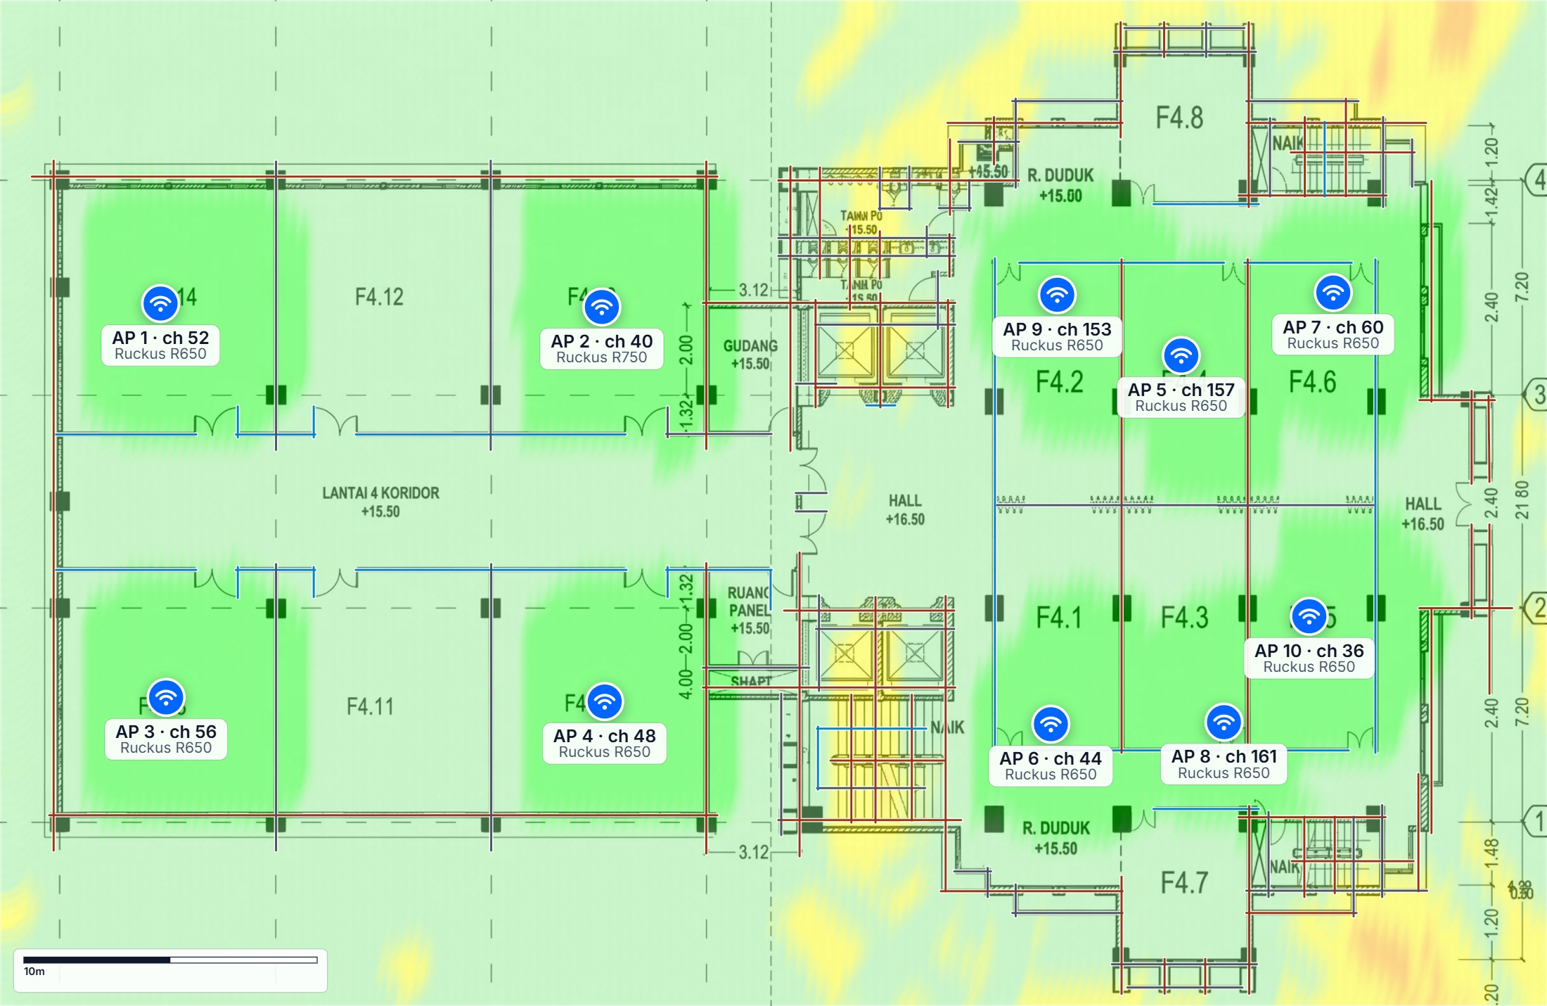
COVERAGE LAYER
Signal-to-Noise Ratio
Signal-to-noise ratio — how far the signal sits above the noise floor.
READING THIS MAP
Voice and video need roughly 25 dB or better; below 15 dB connections become unreliable.
Low SNR in a strong-signal area points to interference rather than distance.
LEGEND
Excellent ≥ 40 dB
Good 30-40 dB
Fair 20-30 dB
Poor 10-20 dB
Bad < 10 dB
Kelompok 6 · Lantai4 · October 11, 2026
5 / 11

Slide 6
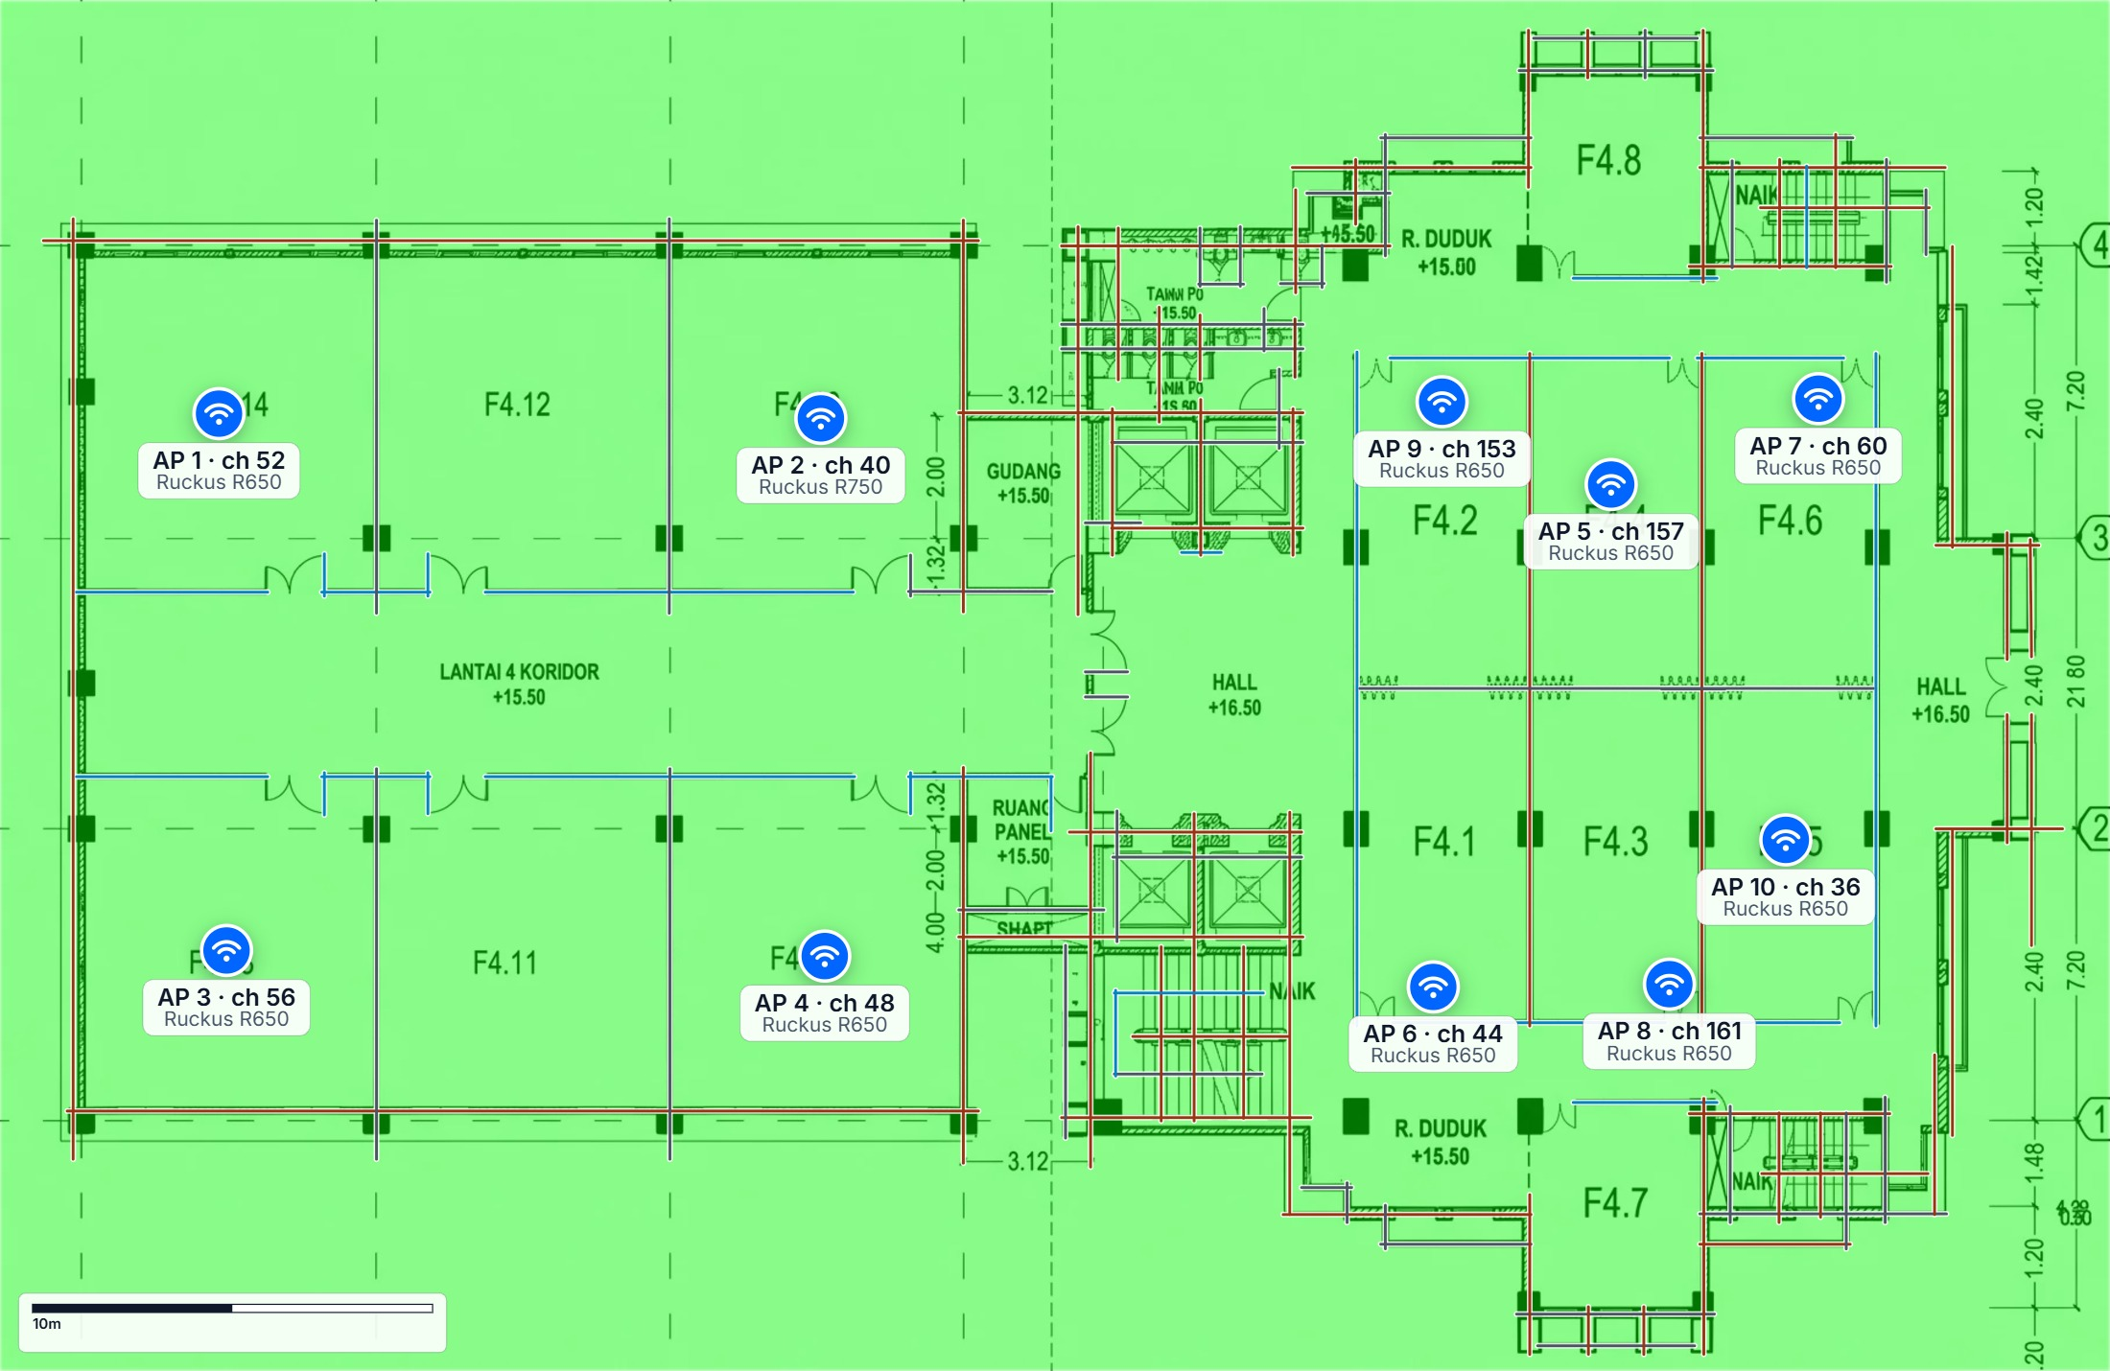
COVERAGE LAYER
Channel Interference
Where neighbouring access points on the same or adjacent channels can hear each other.
READING THIS MAP
Green means each point hears one access point per channel; red means several compete for airtime.
Fix with channel changes or lower transmit power before adding hardware.
LEGEND
None 0-10%
Low 10-25%
Medium 25-50%
High 50-75%
Critical 75-100%
Kelompok 6 · Lantai4 · October 11, 2026
6 / 11

Slide 7

COVERAGE LAYER
User Capacity
Available capacity compared with the demand of the planned number of users.
READING THIS MAP
Green has headroom for growth; yellow is at the limit at peak times.
Orange and red need more radios or users spread across more access points.
LEGEND
Plenty Plenty of room: ≥ 150% of demand
Good Comfortable: 110–150%
Tight Near the limit: 90–110%
Slow Congested: 60–90%
Over Overloaded: < 60%
Kelompok 6 · Lantai4 · October 11, 2026
7 / 11

Slide 8
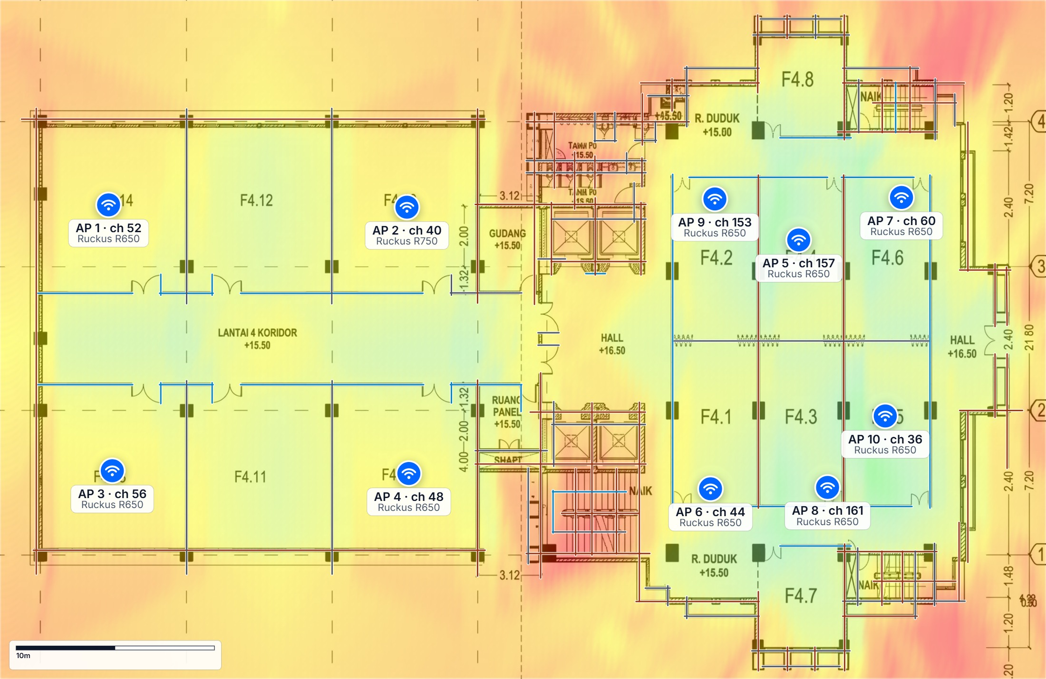
COVERAGE LAYER
Secondary Coverage
Signal from the second-best access point — what a client falls back to when the nearest one fails or is busy.
READING THIS MAP
Strong secondary coverage means seamless roaming and no single point of failure.
Red areas depend entirely on one access point.
LEGEND
Strong ≥ -70 dBm
Good -80 to -70 dBm
Fair -85 to -80 dBm
Weak -90 to -85 dBm
None < -90 dBm
Kelompok 6 · Lantai4 · October 11, 2026
8 / 11

Slide 9
INSTALLATION
Access point schedule
Model, band, channel and transmit power per access point — the installer's configuration sheet.
# | Name | Model | Band | Channel | Tx power | Position (x, y)
1 | AP 1 | Ruckus R650 | 5GHz | 52 | 20 dBm | 5m, 10m
2 | AP 2 | Ruckus R750 | 5GHz | 40 | 20 dBm | 21m, 10m
3 | AP 3 | Ruckus R650 | 5GHz | 56 | 20 dBm | 6m, 24m
4 | AP 4 | Ruckus R650 | 5GHz | 48 | 20 dBm | 21m, 24m
5 | AP 5 | Ruckus R650 | 5GHz | 157 | 20 dBm | 40m, 12m
6 | AP 6 | Ruckus R650 | 5GHz | 44 | 20 dBm | 36m, 25m
7 | AP 7 | Ruckus R650 | 5GHz | 60 | 20 dBm | 45m, 10m
8 | AP 8 | Ruckus R650 | 5GHz | 161 | 20 dBm | 42m, 25m
9 | AP 9 | Ruckus R650 | 5GHz | 153 | 20 dBm | 36m, 10m
10 | AP 10 | Ruckus R650 | 5GHz | 36 | 20 dBm | 45m, 21m
Kelompok 6 · Lantai4 · October 11, 2026
9 / 11

Slide 10
NEXT STEPS
Recommendations
What to do before and after installation.
Predicted coverage is 87.7% — review the orange/red areas on the Signal Strength page and move or add one access point.
Validate the design with a post-installation survey and adjust channels and power from measured data.
Keep the AP schedule with the installation package: positions, models, channels and transmit power are the configuration sheet.
Kelompok 6 · Lantai4 · October 11, 2026
10 / 11

Slide 11
Thank you
Kelompok 6 · Lantai4 · October 11, 2026
Predictions are model-based. Validate with a site survey after installation; channels and transmit power are starting values for the controller.

